Slide 1


Magento Mobile Application
IGATE is now a part of Capgemini

Slide 2
TEAM MEMBERS
Pujarani Parida
Sreya Jaiswal
Shweta Pawar
Saran Madhu
Ragini Ahire.

Slide 3
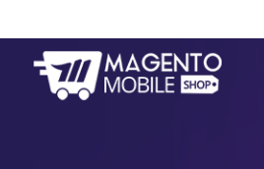
OVERVIEW OF THE PROJECT
In Magento Mobile Application is used for building websites. User buys the domain and then builds his website. User can also add features to his website.
User also have different types of subscription . User also can try this application for free.

Slide 4
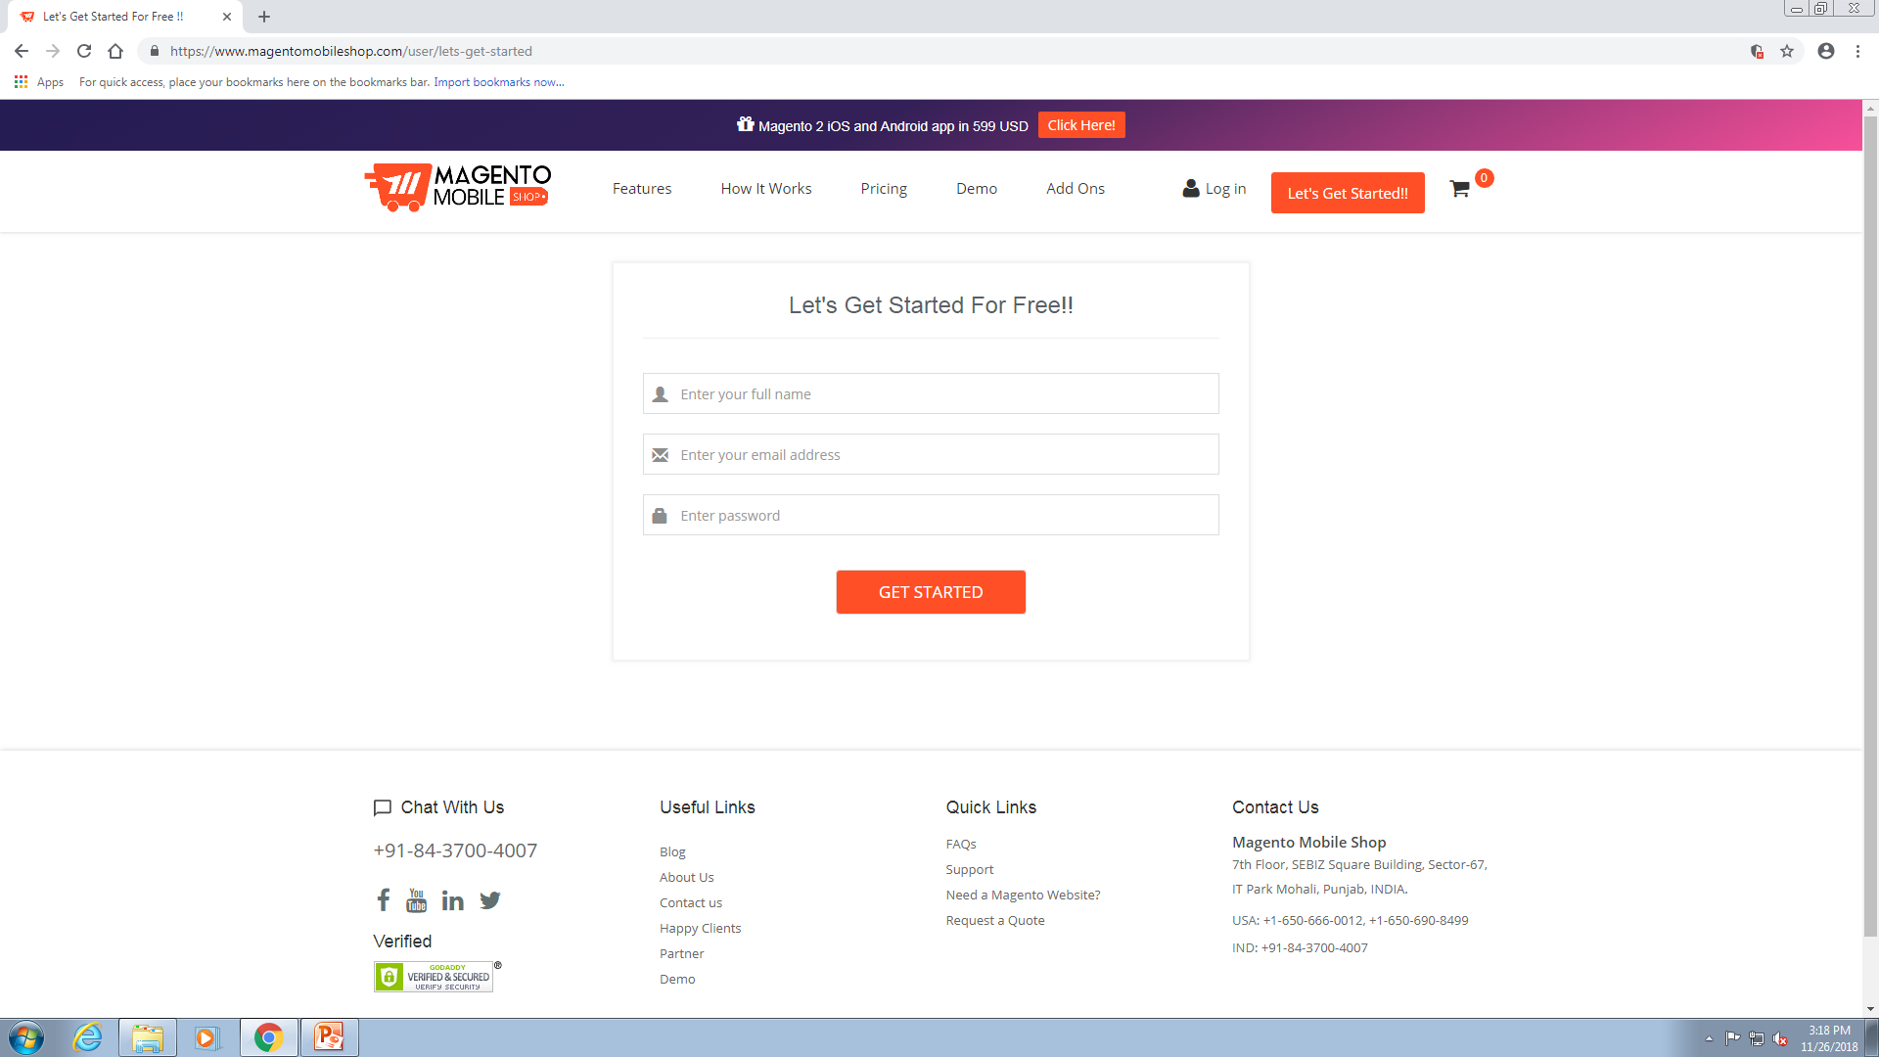
This application includes some modules:
1.Registration Page:
1.On registration page user have to register first.
2.User have to create user name and password for logging into application.

Slide 5
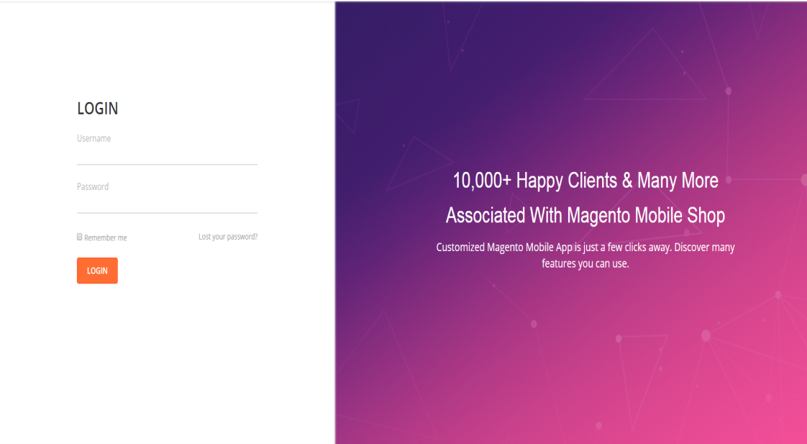
2.LOGIN:
1.On LOGIN page ,user has to enter valid credentials.

Slide 6
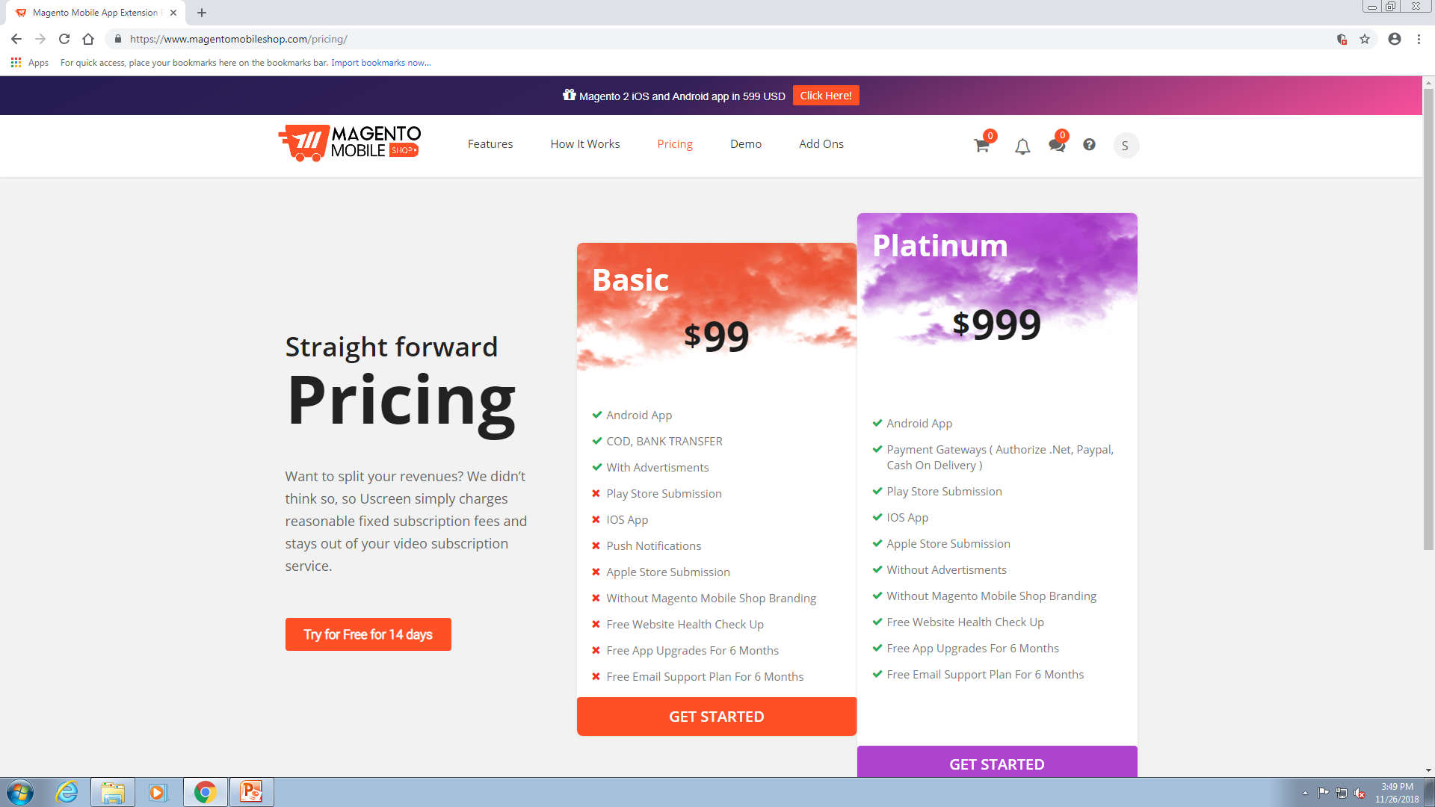
3.Pricing:
1.In this menu user can try this application free for 14 days.
2.There are also two other plans first is Basic plan, where application is only providing the facilities of Android App, COD, Bank Transfer, With Advertisements, by $ 99.

Slide 7
3.The another plan is Platinum plan where user can subscribe by $999, which is providing so many facilities than Basic plan.
4.After choosing any one of the plan application will ask user for register to proceed further.

Slide 8
Actors

Slide 9
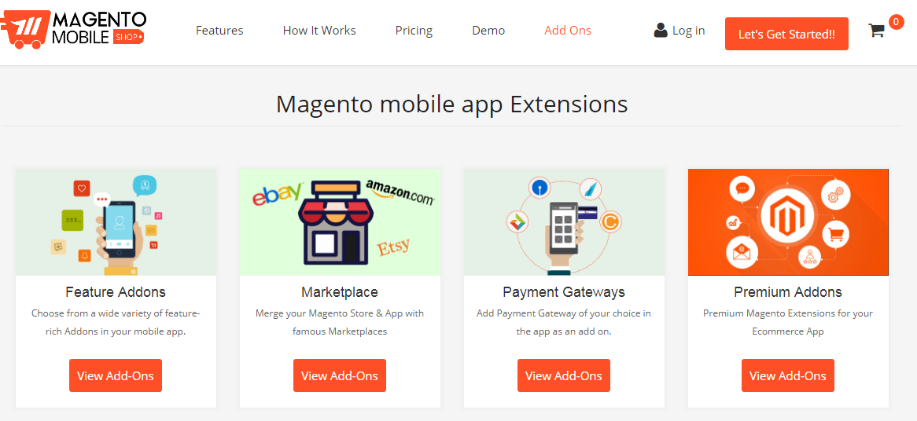
ADD-ONS
1.In this menu different-different features are available to Add in websites which is being build by user.
2. User can select any feature and add it to the cart.
3.After adding in cart further payment process will ne done.

Slide 10
TEST CASES

Slide 11
DFDR

Slide 12
Defects Found…

Slide 13
Application link

Slide 14
Test Case Adequacy :

Slide 15
Test Case Effectiveness:

Slide 16
Tracebelity Matrix

Slide 17
Thank You

